Slide 1
Basic Electrical Components

Slide 2
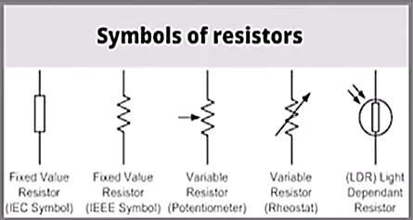
Resistor
The resistor is a passive electrical component that creates resistance in the flow of
electric current. The effect of a capacitor is known as resistance.
Resistors are electronic components which have a specific, never-changing electrical
Unknown Value
voltage
current
resistance
power
heat
Formula
v = I X R
I = V/R
R = V/I
P = V X I OR P =
V2/R OR P = I2R
H=I2RT

Slide 3
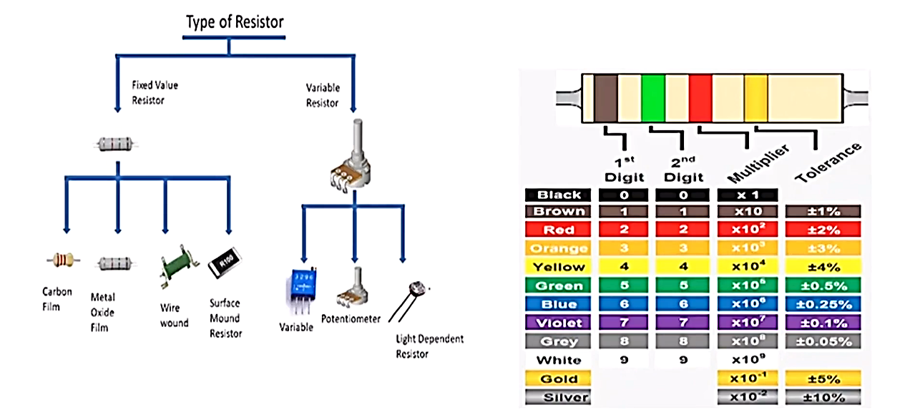
Types of Resistor

Slide 4
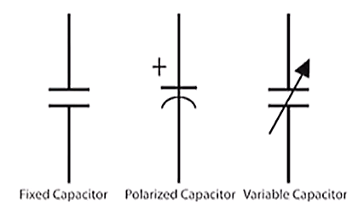
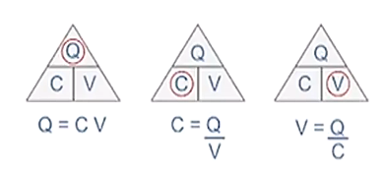


Capacitor
A capacitor is a device that stores electrical energy in an electric field. It is a passive
electronic component with two terminals. The effect of a capacitor is known as
capacitance.
where,
c = Capacitance in Farads
e = permittivity of dielectric (absolute ,not relative)
A = Area of plate overlap in square meters
d = Distance between plates in meters
$$C=\frac{εA}{d}$$
$$E=\frac{1}{2}cv^{2}$$

Slide 5
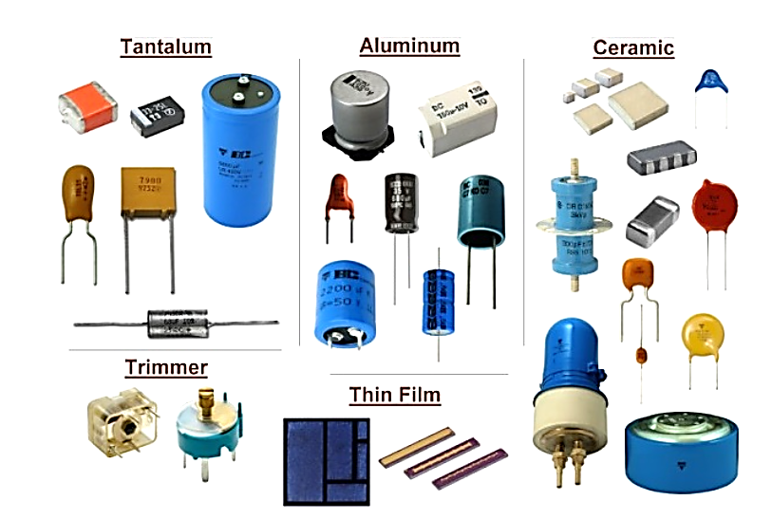
Types of Capacitors

Slide 6
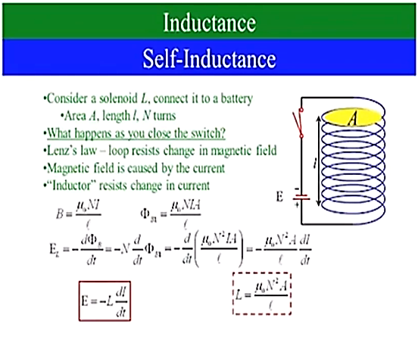
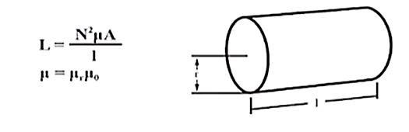
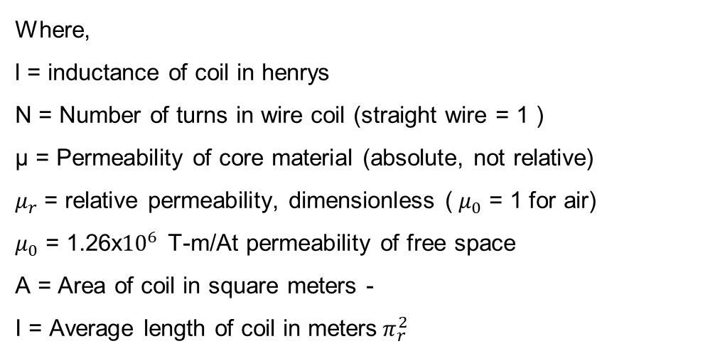
Inductor
An inductor, also called a coil, choke, or reactor, is a passive two-terminal electrical
component that stores energy in a magnetic field when electric current flows through
it. An inductor typically consists of an insulated wire wound into a coil.
Where,
l = inductance of coil in henrys
N = Number of turns in wire coil (straight wire = 1 )
µ = Permeability of core material (absolute, not relative)
$μ_{r}$ = relative permeability, dimensionless (${ μ}_{0}$ = 1 for air)
$μ_{0}$ = 1.26x${10}^{6}$ T-m/At permeability of free space
A = Area of coil in square meters -
I = Average length of coil in meters${ π}_{r}^{2}$

Slide 7
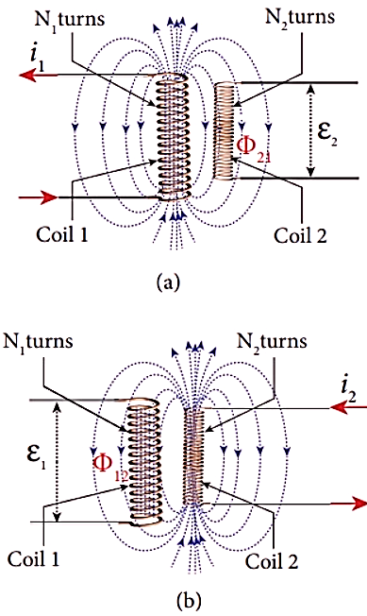
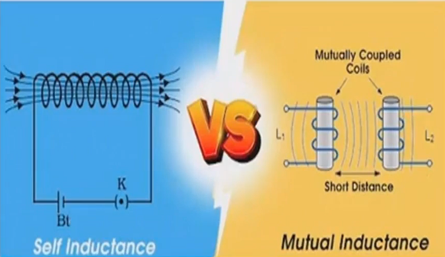
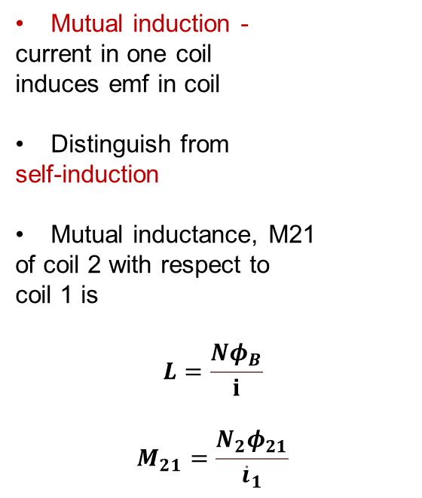
Mutual inductance
Mutual induction -
current in one coil
induces emf in coil
Distinguish from
self-induction
Mutual inductance, M21
of coil 2 with respect to
coil 1 is
$$L=\frac{Nφ_{B}}{ⅈ}$$
$$M_{21}=\frac{N_{2}φ_{21}}{{\dot{i}}_{1}}$$

Slide 8
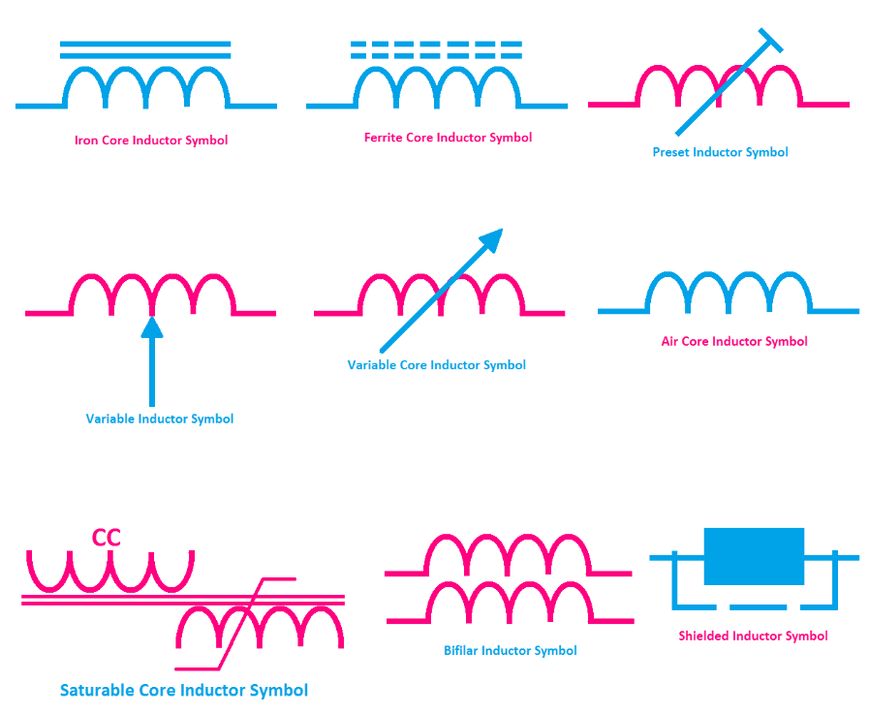
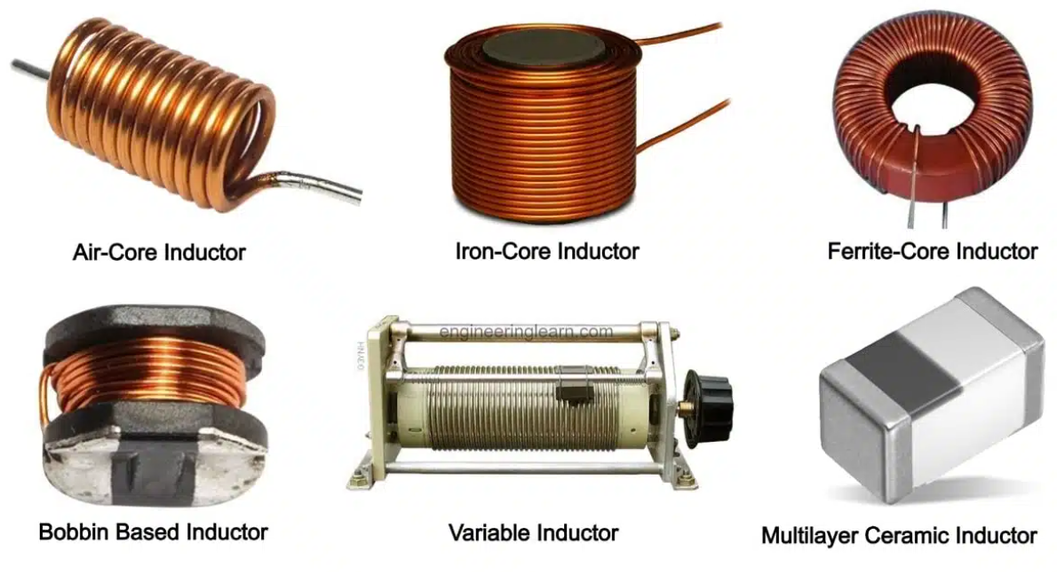
All types of inductor symbols and diagrams

Slide 9



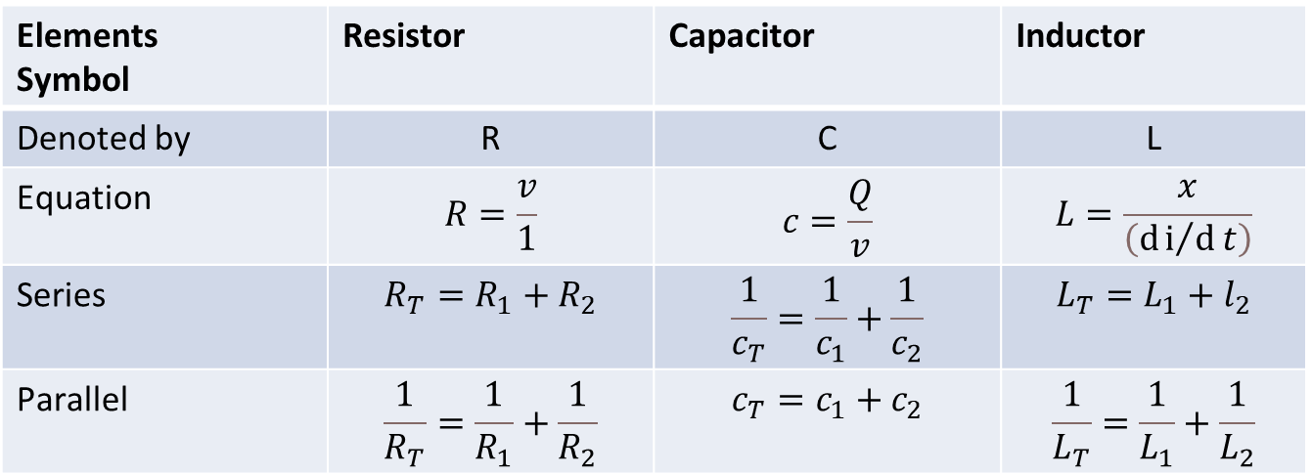
Resistor vs Capacitor vs Inductor
Elements Symbol | Resistor | Capacitor | Inductor
Denoted by | R | C | L
Equation | $$R=\frac{v}{1}$$ | $$c=\frac{Q}{v}$$ | $$L=\frac{x}{\left(ⅆⅈ/ⅆt\right)}$$
Series | $$R_{T}=R_{1}+R_{2}$$ | $$\frac{1}{c_{T}}=\frac{1}{c_{1}}+\frac{1}{c_{2}}$$ | $$L_{T}=L_{1}+l_{2}$$
Parallel | $$\frac{1}{R_{T}}=\frac{1}{R_{1}}+\frac{1}{R_{2}}$$ | $$c_{T}=c_{1}+c_{2}$$ | $$\frac{1}{L_{T}}=\frac{1}{L_{1}}+\frac{1}{L_{2}}$$

